Slide 1
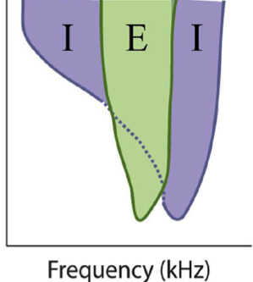

CMR Stimulus Details
Frequency
Co-modulated
CMR
Frequency
Co-deviant
Time
Pressnitzer et al., J Neurosci 2001; Nelken et al., Nature 1999

